Slide 1

Computational Thinking

Slide 2
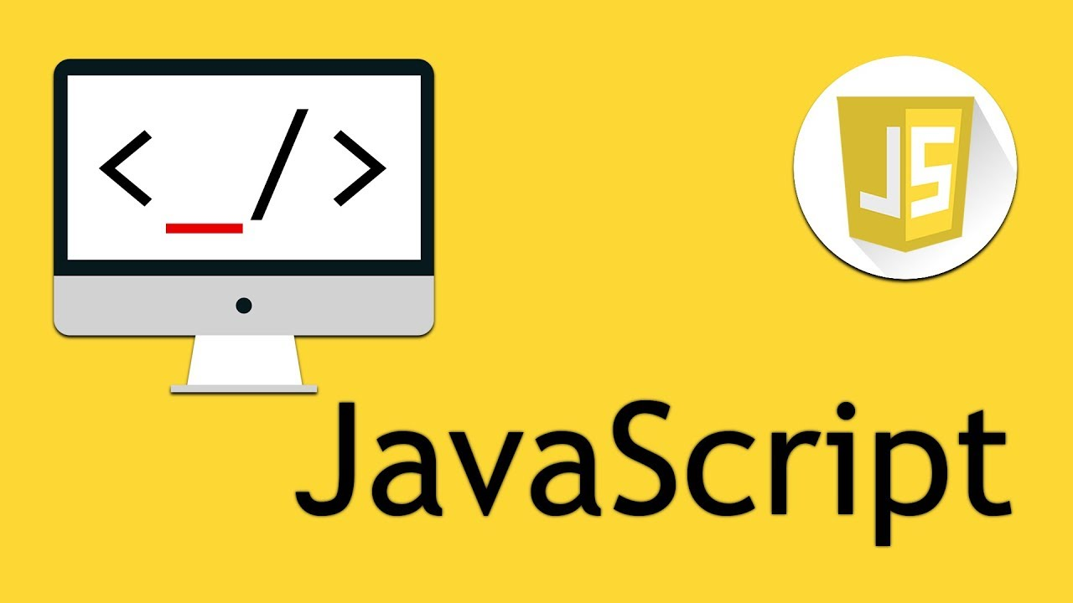

Slide 3
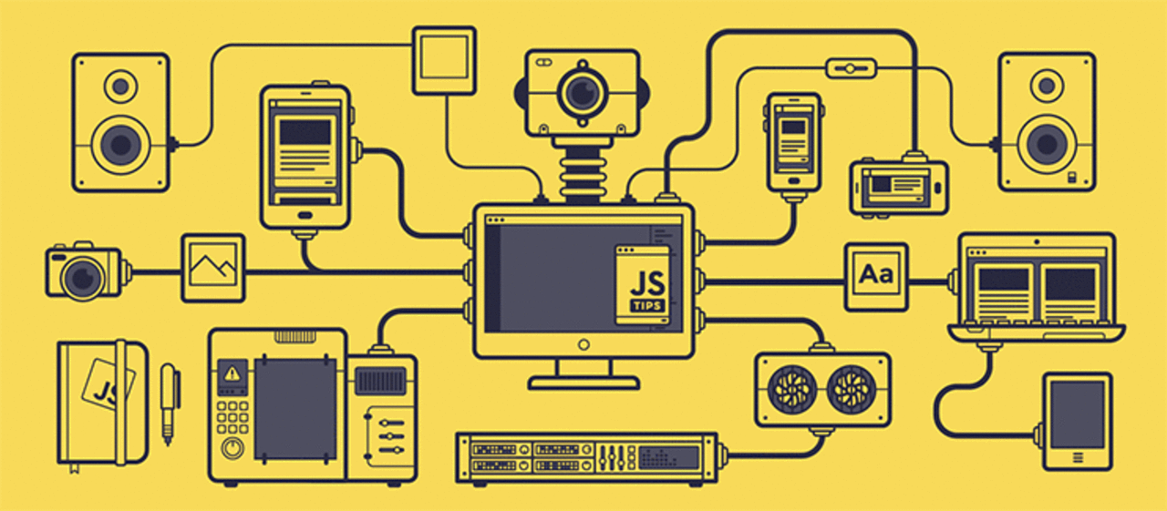

Slide 4


Slide 5
Topics covered
Variables
Arrays
Conditional statements
Loops
Functions

Slide 6
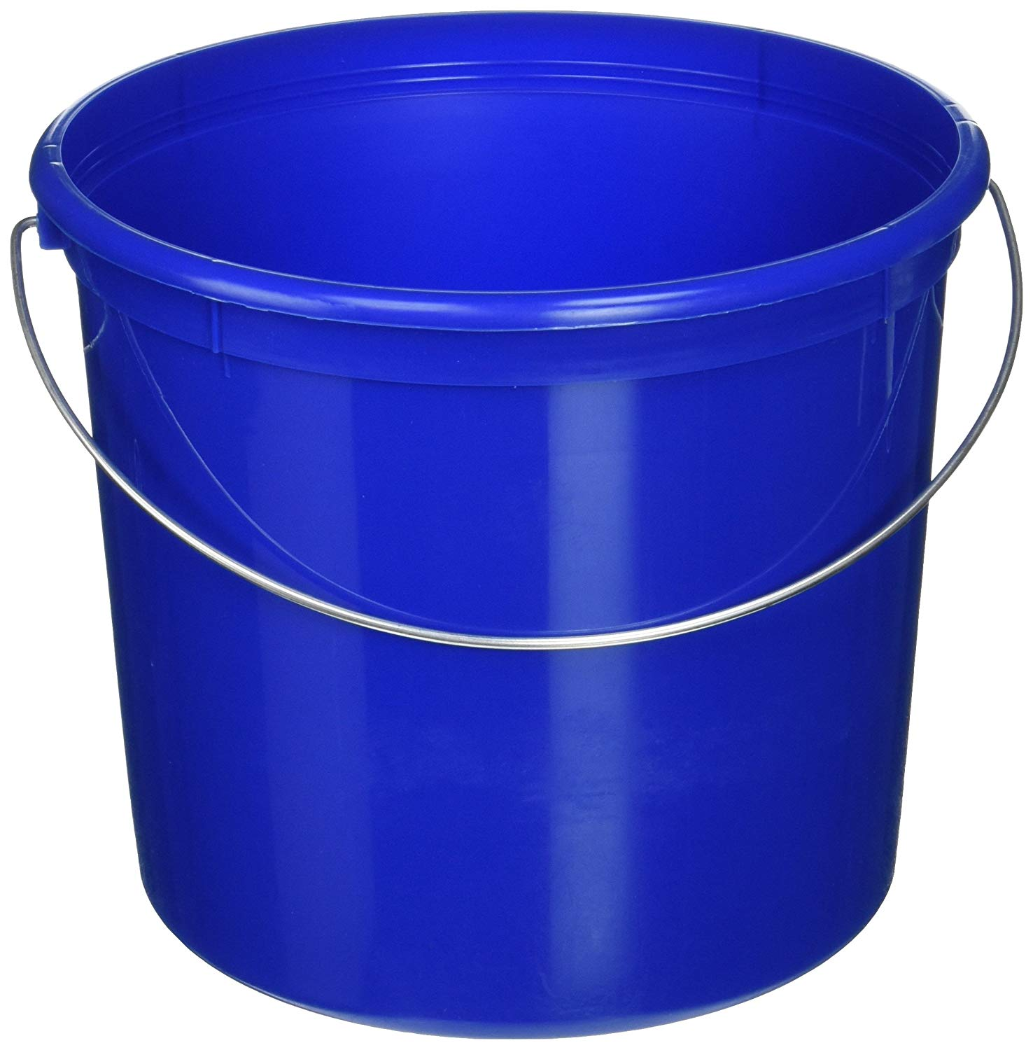
Variables

Slide 7
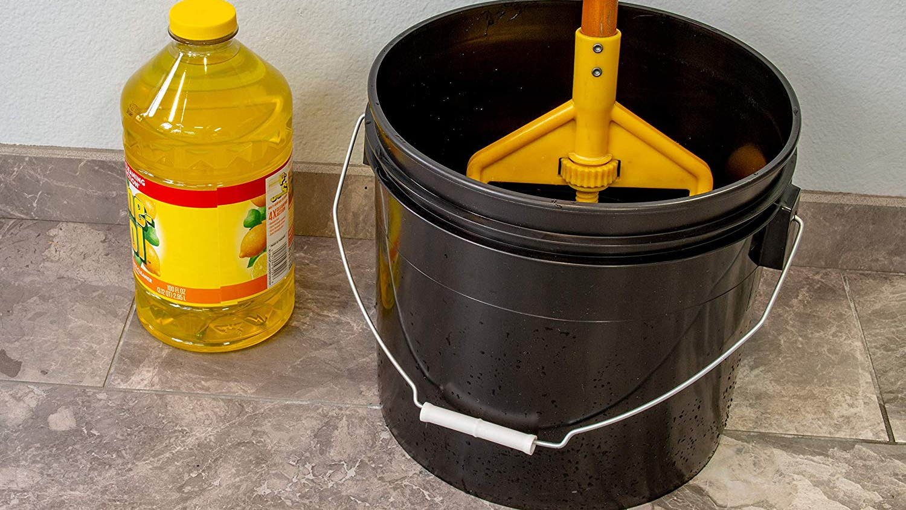

Slide 8
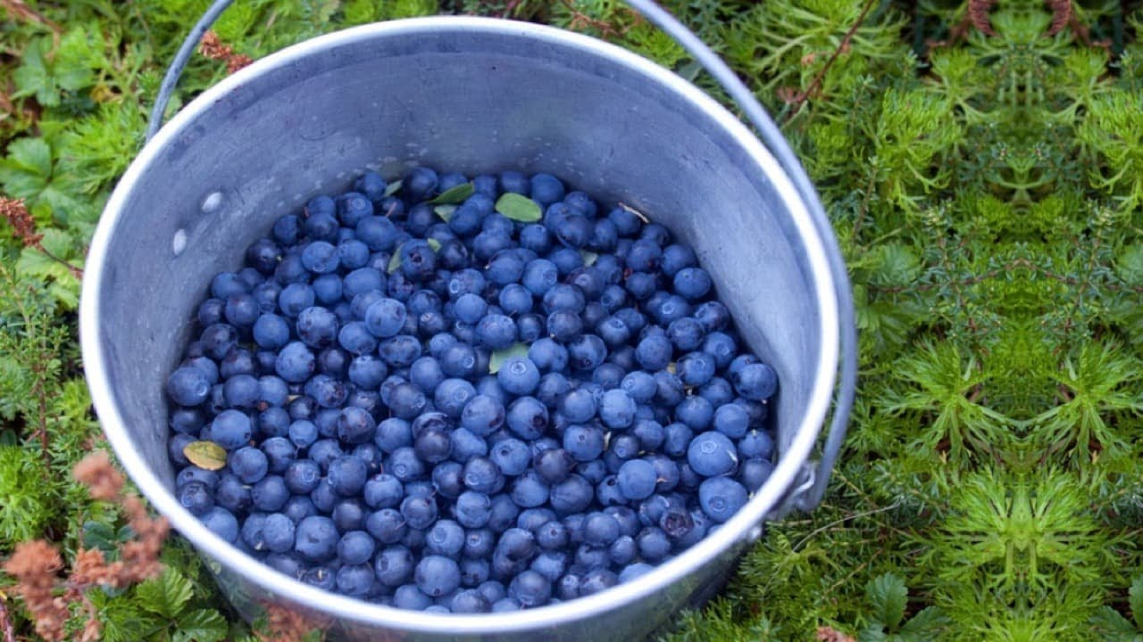

Slide 9
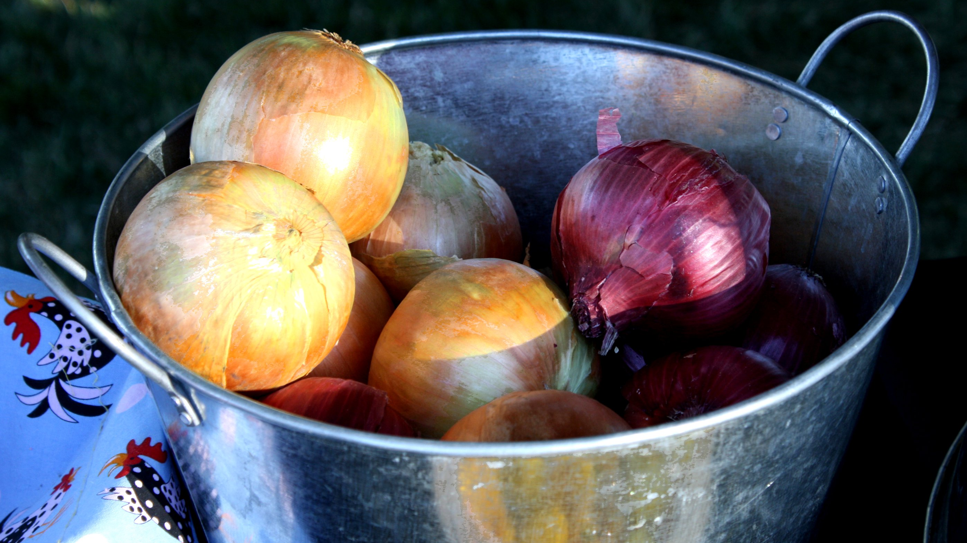

Slide 10


Slide 11
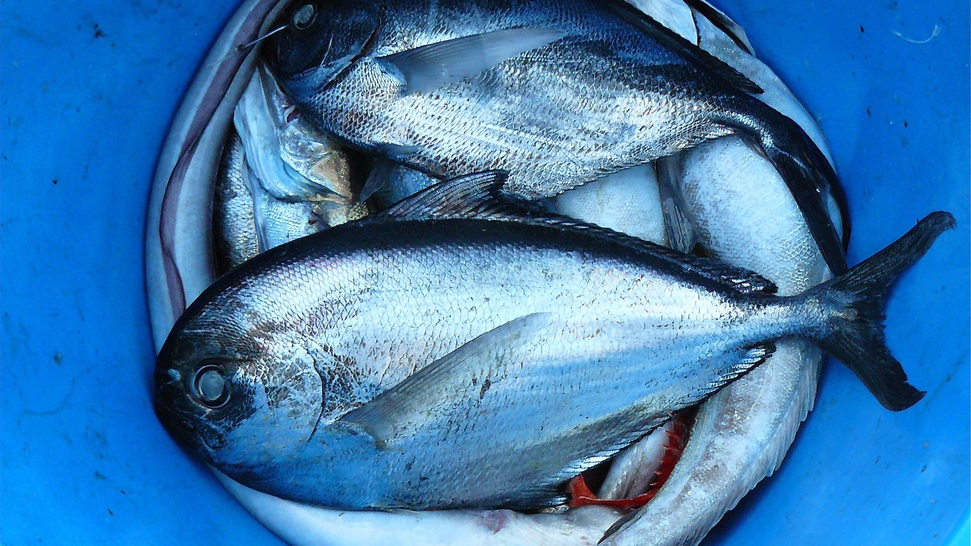

Slide 12


Slide 13
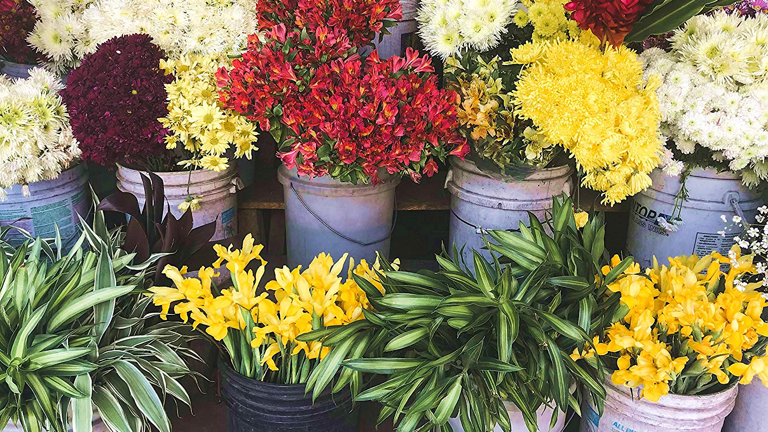

Slide 14
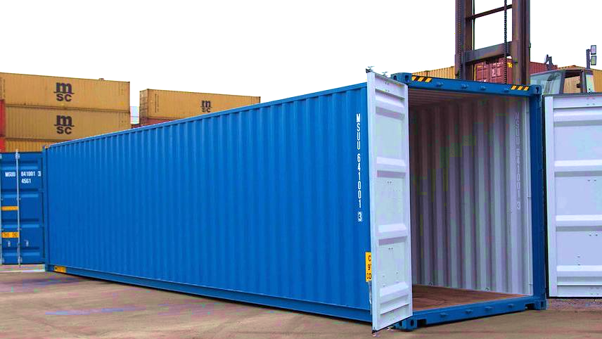

Slide 15
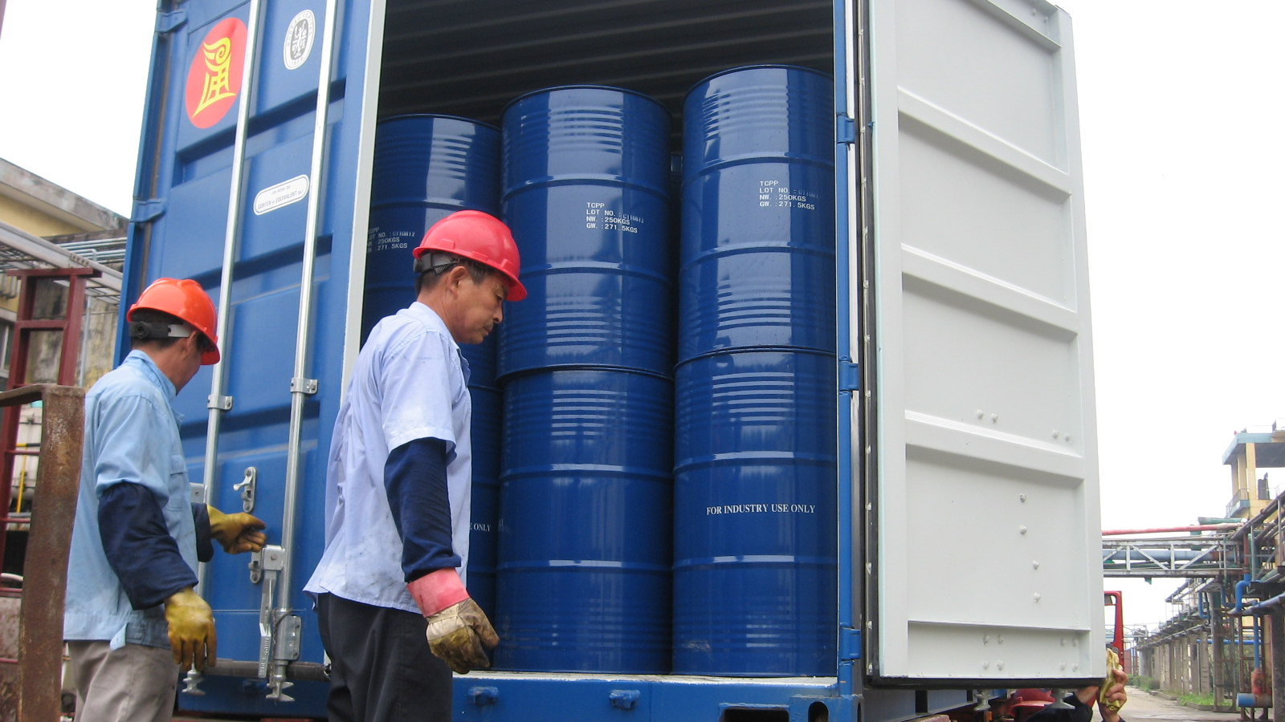

Slide 16
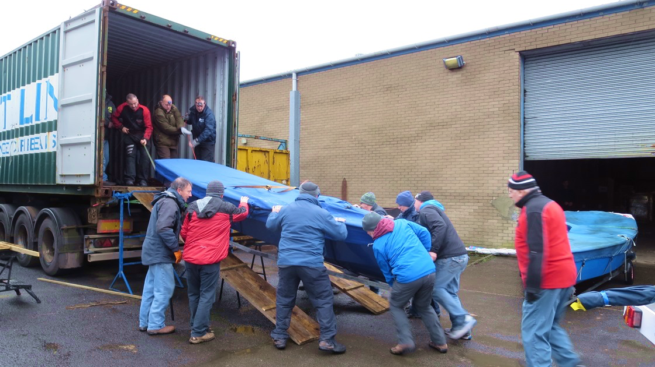

Slide 17
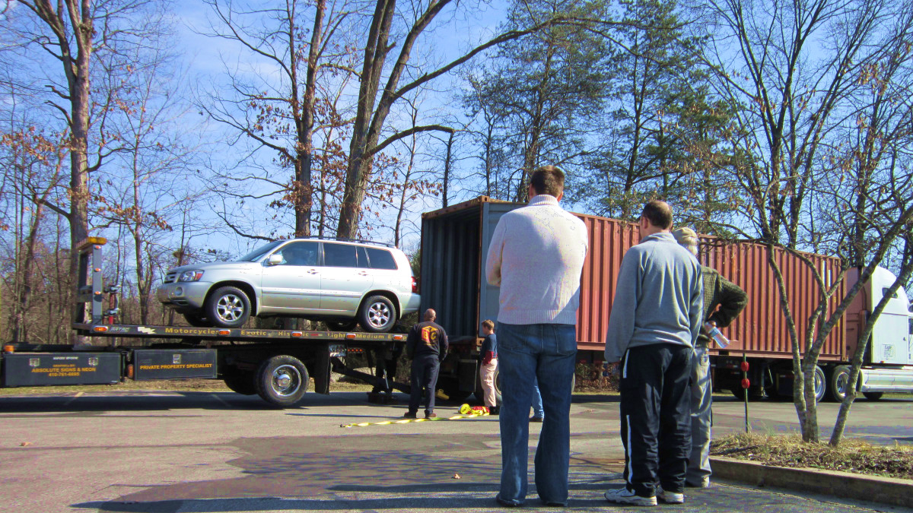

Slide 18
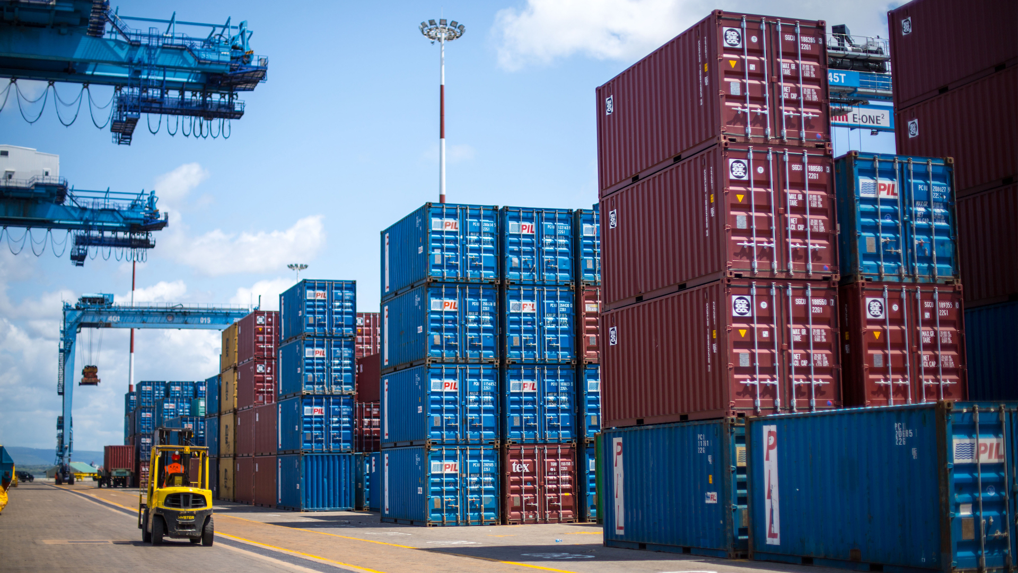

Slide 19
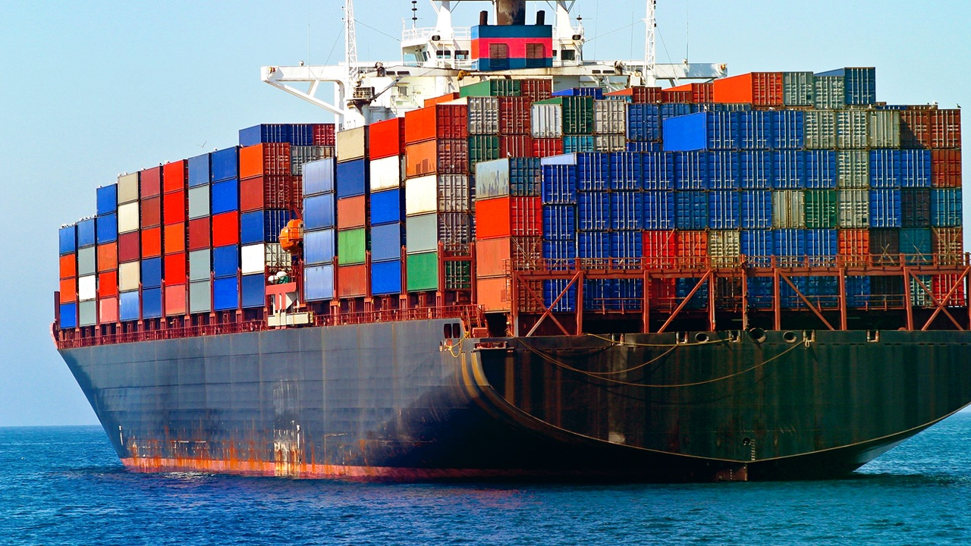

Slide 20

Arrays

Slide 21
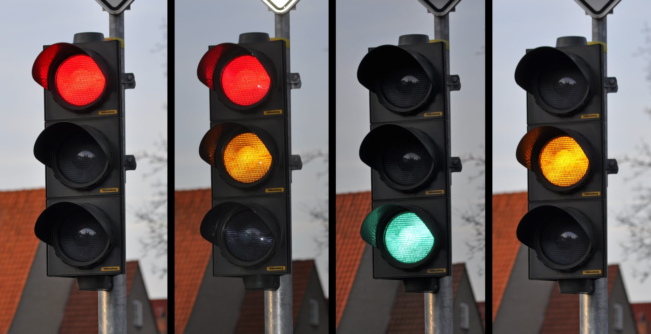
Conditional Statements

Slide 22


Slide 23
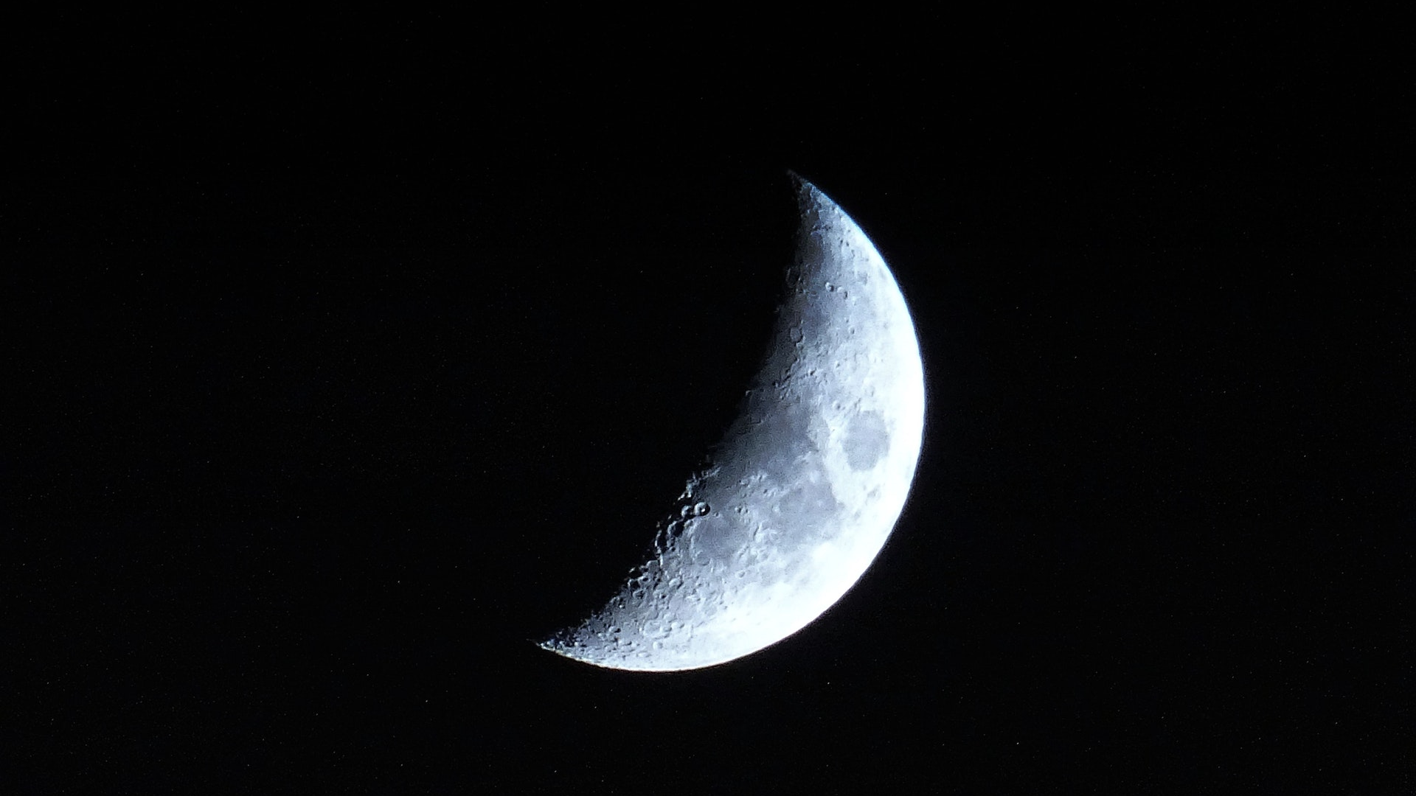
Loops

Slide 24
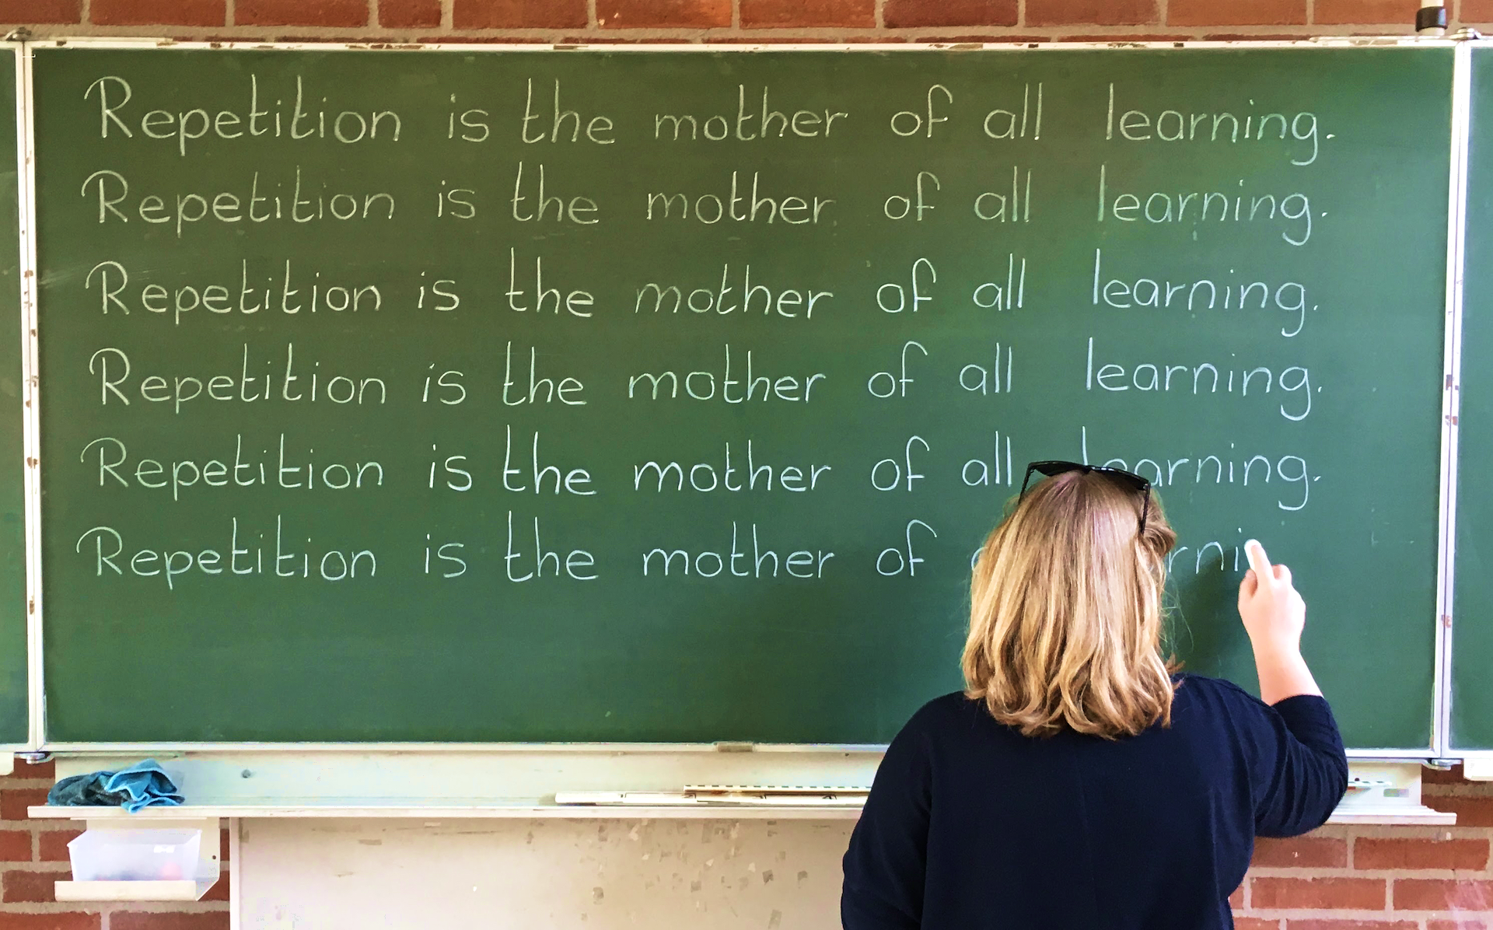

Slide 25


Slide 26
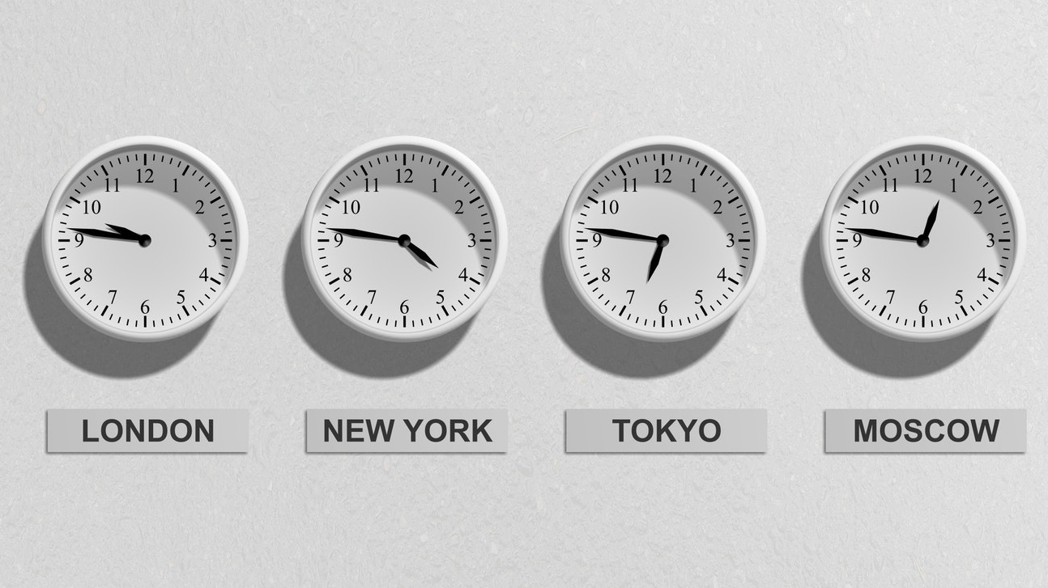

Slide 27
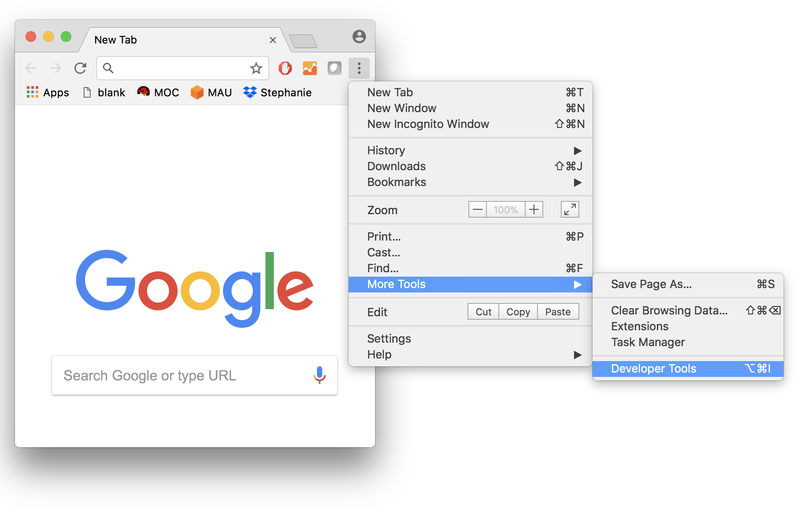
Browser console
Mac: Command+Option+I PC: Control+Shift+I

Slide 28
Active learning
Your turn
Write “Hello world!”
Write a loop that prints number 1 to 1000
Write a loop that prints the multiples of 5 from 1 to 100

Slide 29
functions
function add(a,b){
var result = a+b; return result
}

Slide 30
Create ball function
var ball = create();

Slide 31
Ball size function
var ball = create();
size(ball,200,200);

Slide 32
Color ball function
var ball = create();
color(ball,255,0,0);

Slide 33
Move ball function
var ball = create();
move(ball,50,50);

Slide 34
Random color ball function
var ball = create();
colorRandom(ball);

Slide 35
Functions
ball = create(); // create new ball
size(ball,200,200); // set ball size
color(ball,255,0,0); // set ball color
move(ball,50,50); // move ball
colorRandom(ball); // give ball a random color
zIndex(ball,5); // set ball z-index
repeatMove(ball,10,10,5); // move ball multiple times

Slide 36
Active learning
Your turn
Create a ball
Change color of the ball
Change size of the ball
Change position of the ball

Slide 37
Loops
var counter = 0;
while (counter < 10) {
create();
counter++;
}

Slide 38
Active learning
Your turn
Create 100 balls
Create 1000 balls

Slide 39
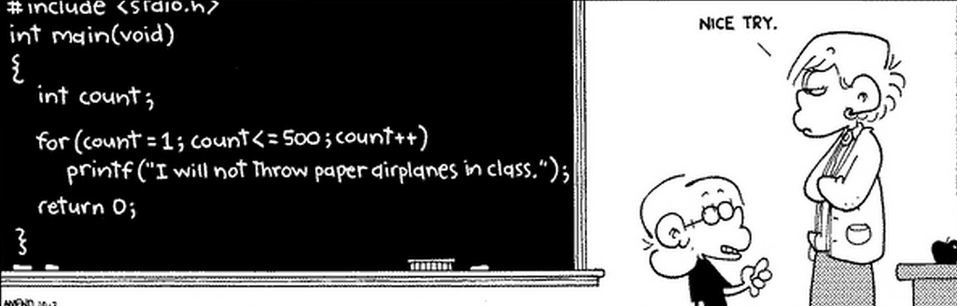
var counter = 0;
while (counter < 500) {
console.log(“I will not throw paper
paper airplanes in class”);
counter++;
}

Slide 40
Arrays
// arrays exercise
var list = [];
list.push(create());
list.push(create());
list.push(create());
list.push(create());
// change color of balls in array
var i=0;
var length = list.length;
while (i < length) {
var ball = list[i];
colorRandom(ball);
i++;
}

Slide 41
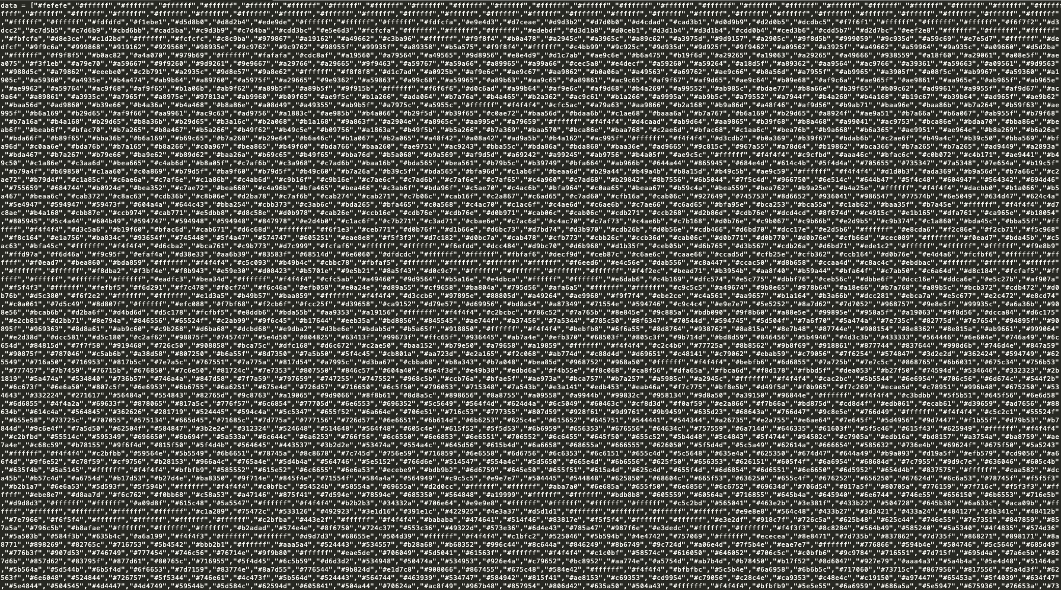
4293
4293 Entries

Slide 42
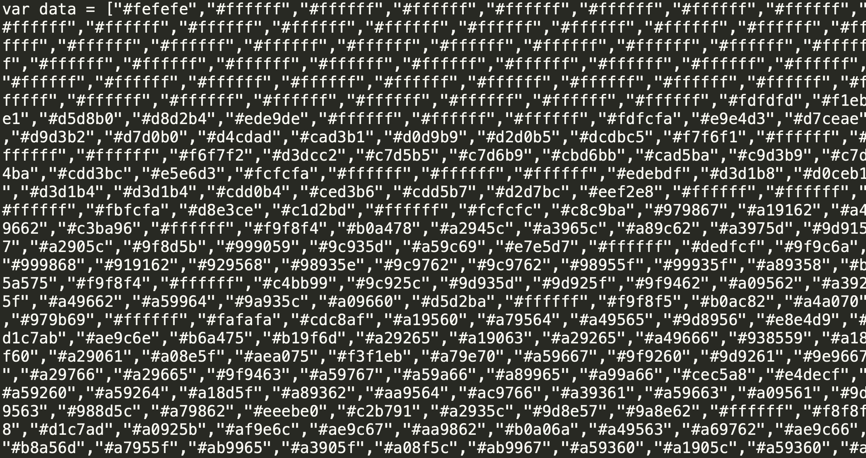

Slide 43
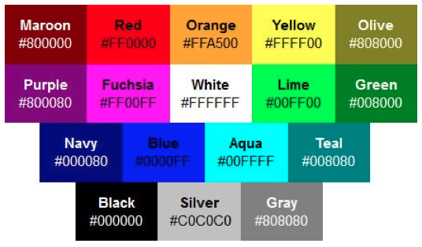

Slide 44
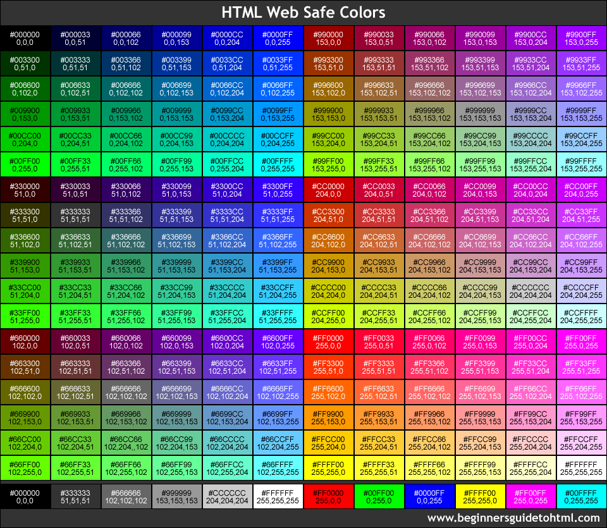

Slide 45
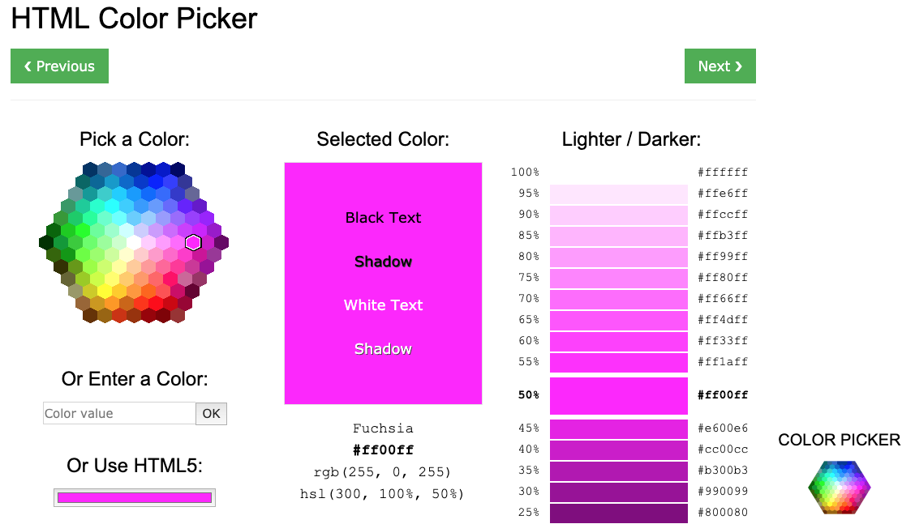

Slide 46
Painting
// length of array with painting information
var length = data.length;
// ith ball
data[i]
// ball x position
ball.x
// ball y position
ball.y
// ball color
ball.color
// create ball at x,y,color
create(ball.x,ball.y,ball.color);

Slide 47
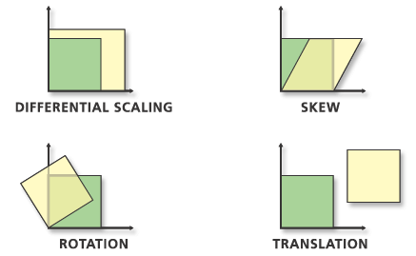
Bonus

Slide 49
